Slide 1
Feature Detection

Slide 2
Contents
Matlab GUI
Feature Detection
Square
Rectangle
Triangle
Pentagon and Hexagon
Eclipse

Slide 3
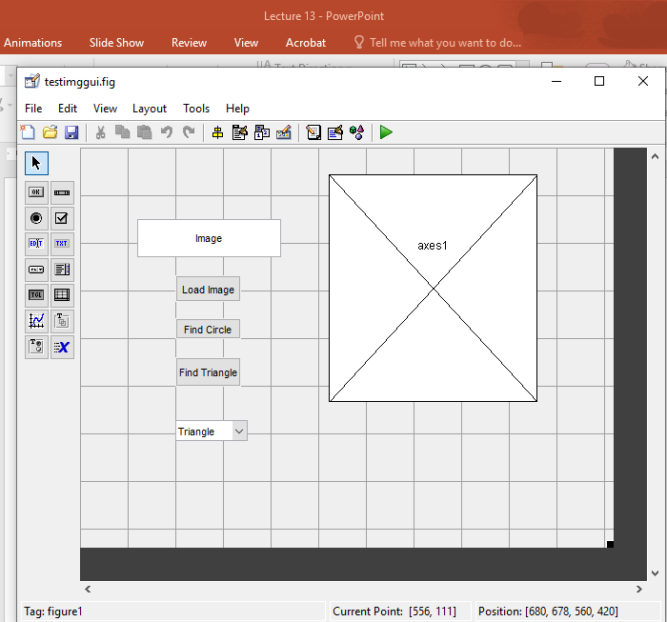
Building a GUI
GUIDE
Axes (for imaging)
Edit Text (to get text)
Push Button (action button)
Popupmenu

Slide 4
Exercise
Read Image (using 2.jpg)
Change RGB to gray scale
Determine the edge using Canny
Remove small areas of non-interest (or noise)
Fill the holes in the image
Get centroid
Get area
Get perimeter
Get boundaries
From boundaries we will calculate the min and max of the distance to the boundary
From the min max, we calculate the estimate area
Compare the estimate area with the area found by Matlab
Determine the shape based on the % of matching (5% of 10%)
If area is not enough to determine the shape
Then use perimeters with the area

Slide 5
Circle
Boundary command
Area
Area = (pi*R²)
Perimeter
S=2*pi*R
(x,y)
R
Cx,Cy)
A=pi*sqrt((Cx-x)²+(Cy-y)²)

Slide 6
Finding Circle

Slide 7
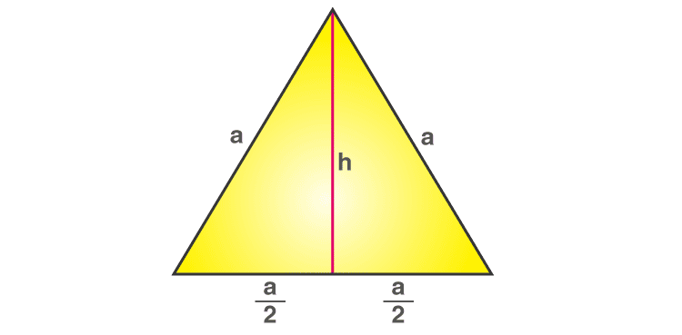
Equilateral Triangle
Max
Area
Area=
Area =
Perimeter
S = 3*a
a=
Min

Slide 8
Finding Triangle

Slide 9
Square
Area
Area = (side A* side A
Perimeter
S=4*side A
Side A
(x,y)
A
Cx,Cy)
A=sqrt((Centroidx-X)^2+(centroid-y)^2)

Slide 10
Finding Square?

Slide 11
Rectangle
Area
Area = Side A * side B
Perimeter
S= 2*side A + 2*side B
Side A
Side B

Slide 12
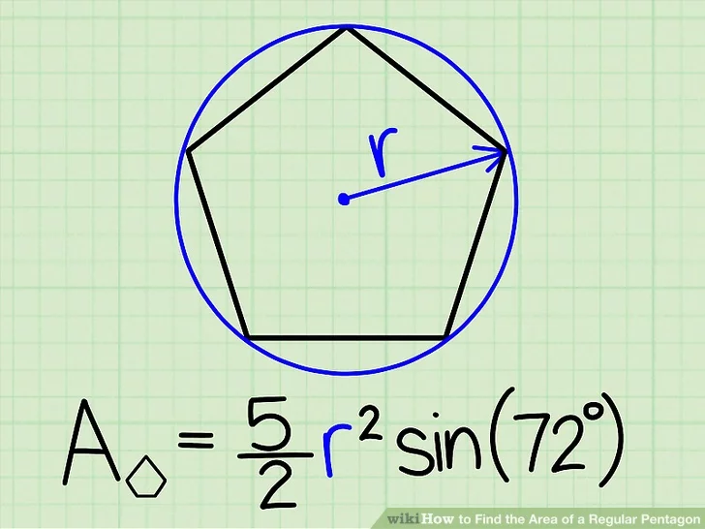
Pentagon and Hexagon
Pentagon Area
Area=
Perimeter
S=5*side A
Side A =
Hexagon Polygon
Area =
Perimeter
S=6*side A
Side A =
b

Slide 13
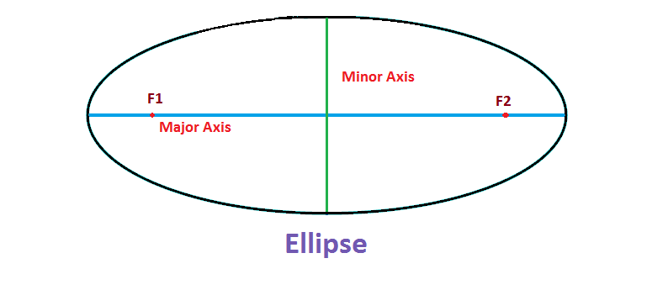
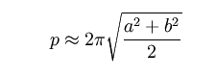
Ellipse
Area
Area=Pi*F1*F2
Perimeter
a
b

Slide 14
Quiz 1
Determine the all of the shapes in the figure provided

